Slide 1

biography
michel Esteban escarraga rivera was born on 12/20/2000 in acacias meta

Slide 2
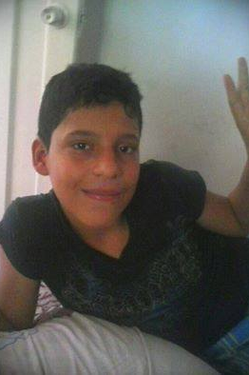
childhood
He was an intelligent boy who excelled in primary and secondary school.

Slide 3
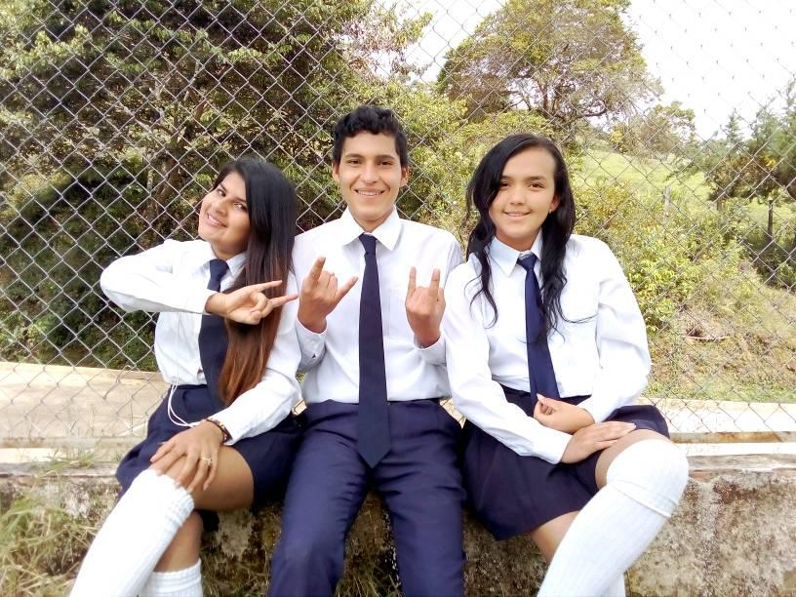
graduation
He graduated on 09/12/2019 and was looking for job stability but could not because on those dates there was a pandemic that affected the country's economy

Slide 4
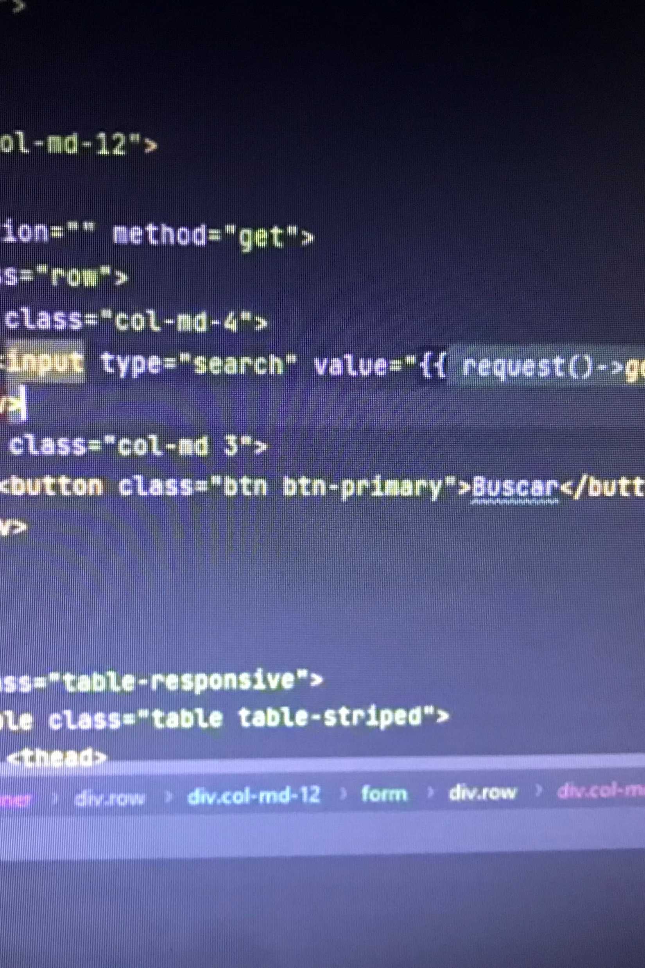
options
in 2021 he tried to enroll in the unal but he was unsuccessful so he applied in the sena with the technologist in adsi and he is not doing badly

Slide 5
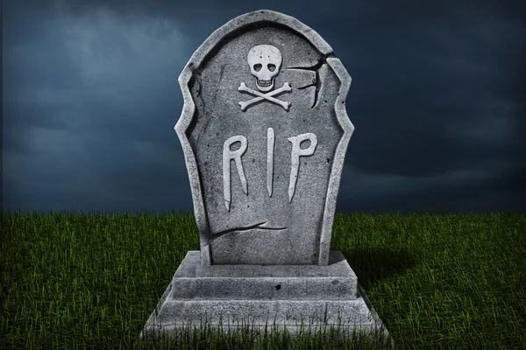
death
sadly deceased of an electric shock that same year for not using proper protection

